Slide 1
Md Zehad Ali ID: 20244203141 Intake: 47 (DH) Program: B.Sc. Engg in CSE
Welcome Everybody

Slide 2
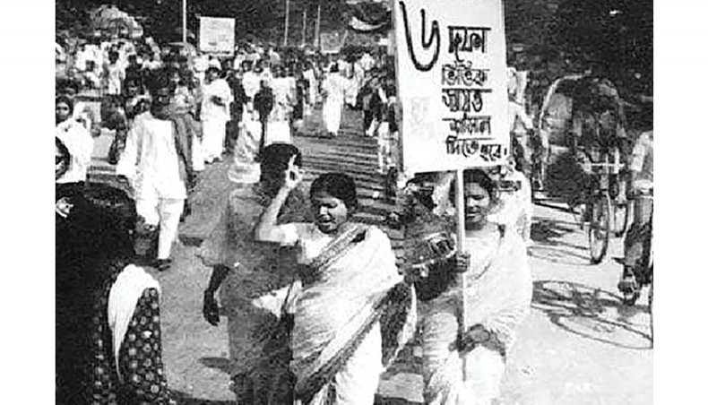
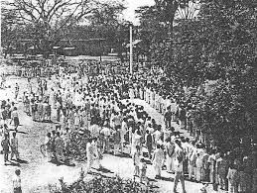
SIX-POINT MOVEMENT SIGNIFICANCE & RESPONSES
Image - 01
Image - 02

Slide 3

The Six Points
Federal System: East Pakistan wants more control over its own government.
Currency Control: Separate currency to protect East Pakistan’s money.
Local Taxes: East Pakistan collects and controls its own taxes.

Slide 4
The Six Points
Trade Freedom: Control over its own trade policies and resources.
Military Independence: East Pakistan can have its own local defense forces.
Foreign Affairs: Control over foreign aid and trade agreements independently.

Slide 5
Significance of the Six-Point Movement
Demand for Autonomy
Path to Independence
Political Empowerment
The movement marked the first formal demand for provincial autonomy within Pakistan, challe- nging West Pakistan's centralized control.
The Six Points were seen as a step toward full independence, as they highlighted that East Pakistan could no longer endure exploita-tion by the West.
The Six-Point Movement represented a signifi-cant shift in political consciousness among the Bengali population.

Slide 6
Responses to the Six-Point Movement
West Pakistan’s Response
East Pakistani Students
International Awareness
The ruling government in West Pakistan, domi-nated by the Pakistani military and political elites, viewed the Six-Point demands as a threat to the unity of the country.
Students in East Pakistan were among the most fervent supporters of the Six-Point Movement. They organized rallies, protests, and strikes to demand regional auto-nomy.
The movement attract-ed international atten-tion, with foreign media covering the growing rift between East and West Pakistan.

Slide 7

Conclusion
The Six-Point Movement became a turning point in the Bengali nationalist struggle, symbolizing a desire for self-determination that ultimately culminated in the indepen-dence of Bangladesh in 1971.

Slide 8
Any Questions?
Thank You! Everybody

